Slide 1

Washington University, St. Louis
Data Analytics Bootcamp – Final Project
COVID-19 Risk Calculator
By: Michael Becker, Leo Huang, Aukje Rijpkema, Joseph Yi

Slide 2

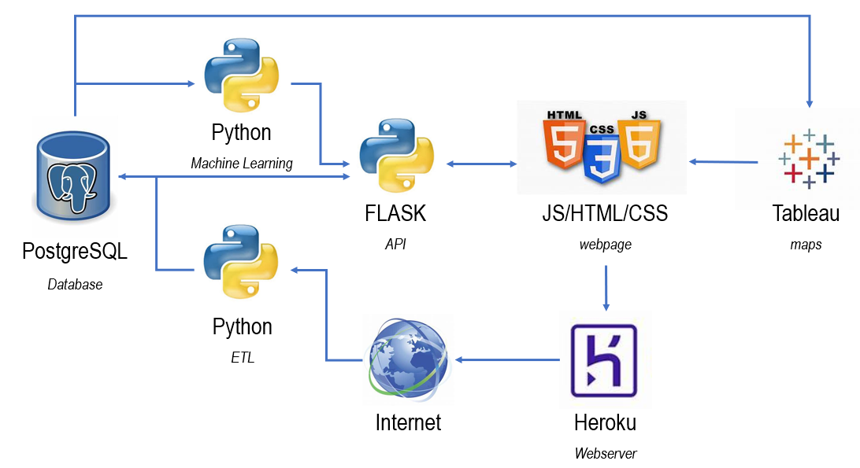
Architecture

Slide 3
Architecture - Details
PostgreSQL Database 6 datasources – 10 views
Python ETL full + delta loads
Python ML 4 models
FLASK API 8 routes – 4 API endpoints
HTML/CSS/JS frontend web-application
Tableau integrated in web-application
Heroku application deployment

Slide 4
Application Functionality - Overview
Home Page – Race Chart by State
Risk Calculator Page – Find out how much you are at risk
Visualization Page – Geographic display of spread
Charts Page – Statistics by Country, State and County
About Page – Our Roles and Profiles
CDC-site – More information

Slide 5

Application Functionality: Web Design
Design and Content
Minimalist Design
Neutral color palette
Dynamic interactions with texts, alert boxes, and animated nav bar
Dynamic bar chart race
Text contents
Improvements

Slide 6
Application Functionality: Risk Calculator Page
Python ETL: Data from 2 early datasources:
~1000 closed cases (mostly hospitalizations + death)
~ 14000 open cases (tested positive but never reported back)
SQL: Data cleanup / reformatting to make consistent reporting possible
Python 4 Machine Learning models created and saved
Decision Tree
Deep Learning
Random Forest
K-Nearest Neighbor

Slide 7
Application Functionality: Risk Calculator Page cont.
JavaScript (HTML/CSS) input page allows for choice of:
Model
Age/Gender
Living/Travel Locations
Preconditions
Symptoms (12)
Result passed through FLASK API to retrieve predictions from chosen model
‘Model Evaluation’ chart - ML-model accuracy per gender/age subset

Slide 8
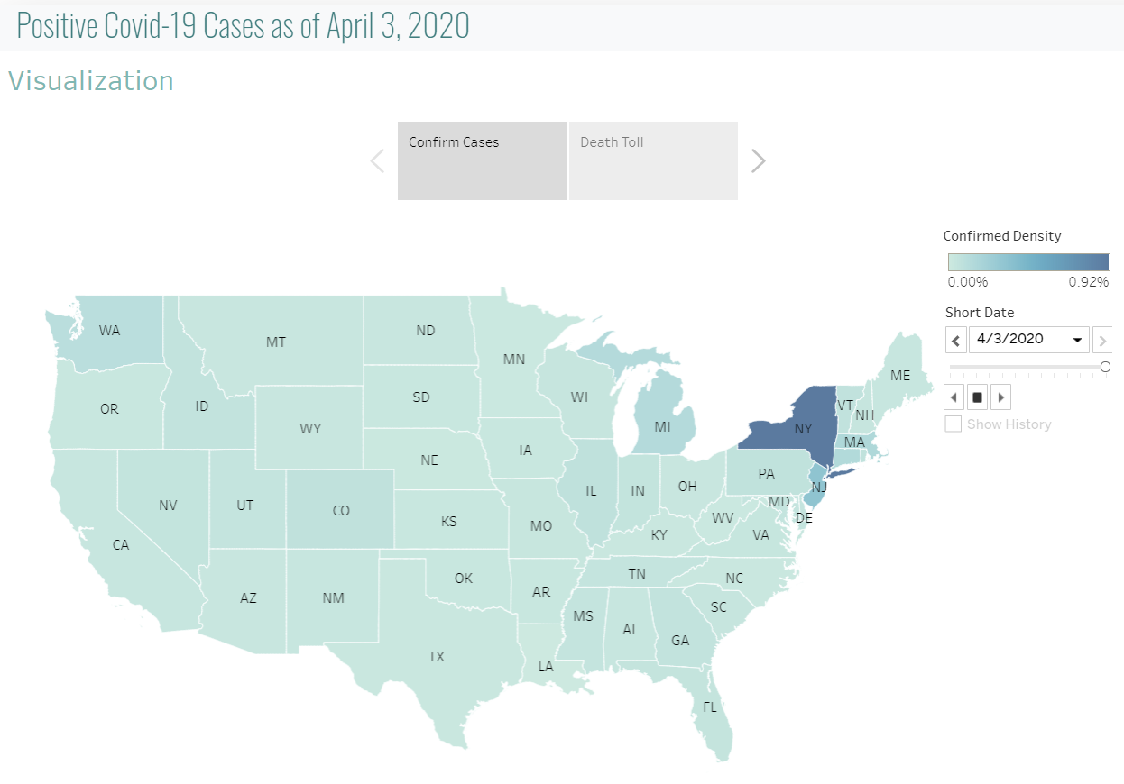
Application Functionality: Visualization Page

Slide 9
Application Functionality: Charts Page
5 Graphs with dropdown boxes for selection:
by Country – total positive, recovered, deceased
by State – total home and hospitalized, recovered, deceased
by State – daily positive case increase
by State – daily hospitalized and deceased increase
by County – total positive, recovered, deceased

Slide 10
Ambitions – What else we would like to do
Run ML models on more reliable, consistent data + larger dataset
Extend ML models with extra features (BMI, smokers, preconditions)
Add SVG of a Human to show percentages of symptoms

Slide 11
Questions?

